Slide 1
Reviews Customer Feedback
- Deep Mehta

Slide 2
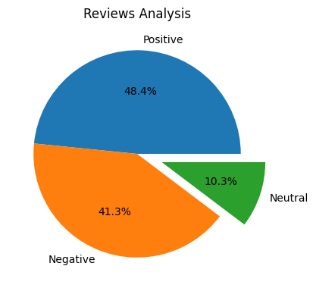
Distribution of Reviews

Slide 3
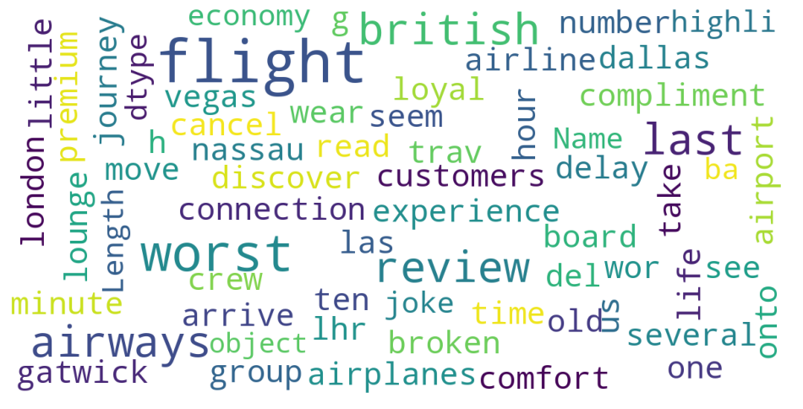
Word Cloud of Reviews

